Slide 1

VINDHYA INSTITUTE OF TECHNOLOGY & SCIENCE SATNA
E-COMMERCE WEBSITE
OUR HOUSEKEEPER
Under the Guidance of:-
CP GAUTAM SIR
Asst. prof. (CSE)
Presented By:-
PAWAN CHATURVEDI
Enrol No. 0302CS181024
Mr. Pradeep Tripathi
HOD (CSE)
VITS, Satna

Slide 2
MODULES OF THE WEBSITE
There are some module of our website or we can say some section of our website ….
Module 1:- gather idea and presentation…
Module 2:- header
body
footer
Module 3:- database connectivity….
Module 4:- ambiguity testing
Module 5:- working project in final presentation…

Slide 3
Work to be done
I have done module 1,2,3 of my entire project
In the 1st module I done all the presentation work
In 2nd module I done all header section in which navigation bar and it’s parts are done ,then body section work had done,
In 3rd module if we talking about we done all the database connectivity to our project…

Slide 4
Module 1
Gather ideas and presentation ---
in the module 1 we are going to talking about all ideas and creativity of the entire project which is also done by us…
and in previous presentation we discussed all the basic and detailed information about home service website…
like:--
abstract
introduction
literature survey
scope and future work
conclusion etc…

Slide 5
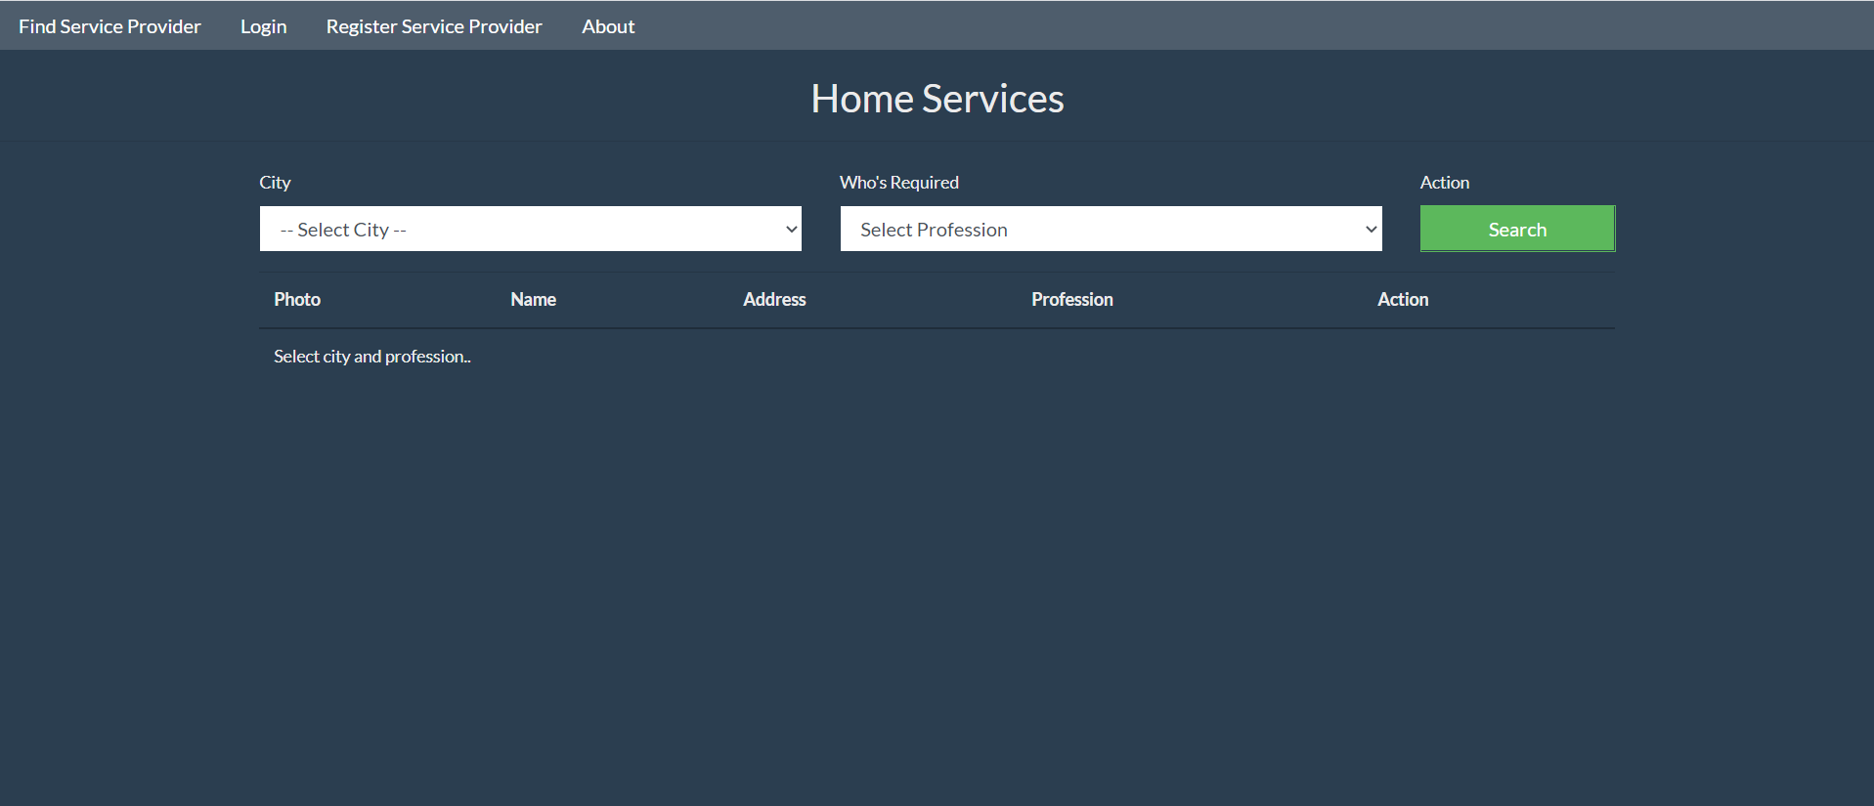
Module 2
In module 2nd we are discussing about frontend of the website which are directly interacted with the end user or client ….
Header section:-- in header section we made navigation bar

Slide 6
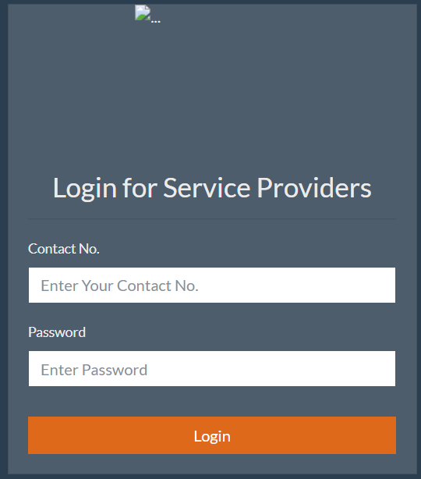
Login page:----

Slide 7
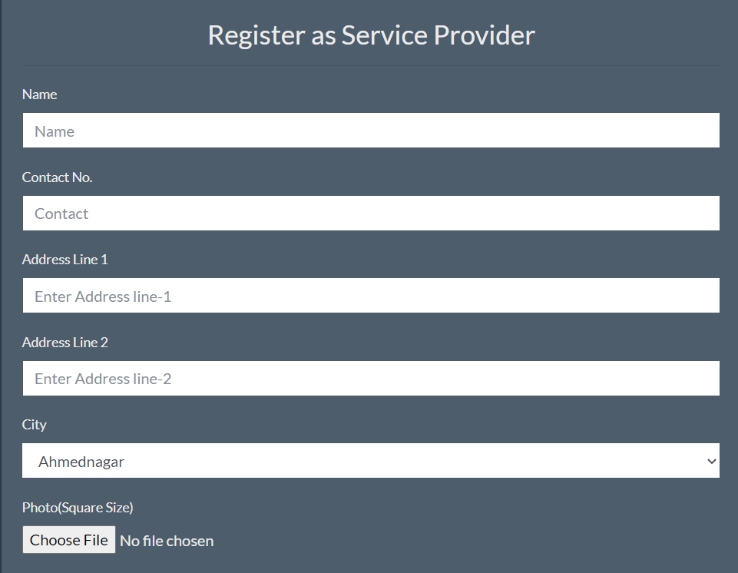
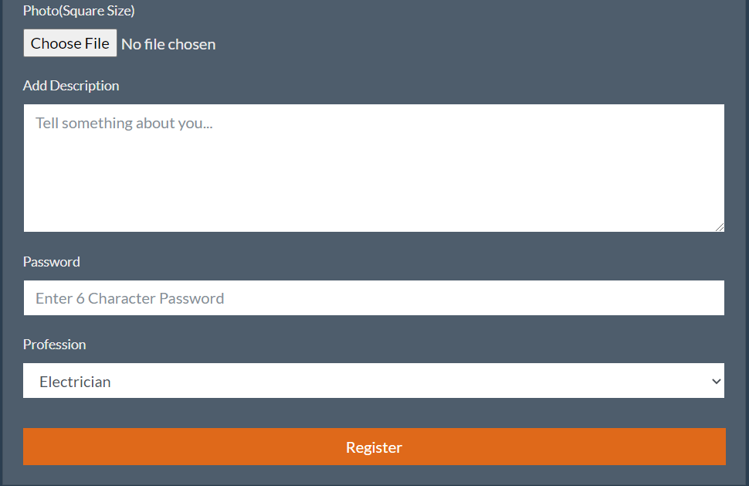
Registration as service provider

Slide 8
Module 3
In the module 3rd we provide all the pages to their individually data base..
Technology used—
In my website I use MYSQL as a database technology .
I will need to use one or more server side scripts to connect to my database to making connection to a mysql system within a PHP script.
XAMPP server …to provide local server to run project…

Slide 9
Remaining work
The last two modules are remaining :--
Module 4:- after completing the project we will check the ambiguity and all the basic problem comes under the entire project and try to make our website more attractive…..
Module 5:- at last we present our project….

Slide 10
THANK YOU

